Slide 1
Topics to be Covered
Special Probability Distributions
  Bernoulli Distribution
  Binomial Distribution
  Negative Binomial Distribution
  Geometric Distribution
  Poisson Distribution

Slide 2
Bernoulli Distribution
If an experiment has two possible outcomes, success and failure and the probability of success is θ. Then the number of success, x, ( x є {1,0}) has a Bernoulli distribution
named after James Bernoulli

Slide 3
Bernoulli Distributions
Definition
A random variable X has a Bernoulli Distribution and it is referred to as a Bernoulli random variable if and only if its probability distribution is given by
f(x;θ) = θ^{x}(1- θ)^{1-x} for x = 0,1
f(0, θ) = 1- θ - the probability of failure
f(1, θ) = θ - the probability of success

Slide 4
Law of Large Numbers
Definition
if ϵ > 0, as n becomes arbitrarily large
the probability approaches 1
that the fraction of times an event E occurs
during n trials is within ϵ of p(E).
Theorem introduced by Bernoulli

Slide 5
Binomial Distribution
Example
Find the probability of getting 2 heads and 2 tails in 4 flips of a balanced coin
Solution
What is the probability of getting 2 heads?
(½)(½) = ¼
What is the probability of not getting two heads?
(1 - ½)(1 - ½) = ¼
The question asked for 2 heads in four flips. Therefore we must evaluate the probability of getting 2 heads and (4-2) tails
(½)²(½)² ⁼ 1/16
Does this answer the question?

Slide 6
Example
This tells us the probability of getting 2 heads and 2 tails in any one specific order
i.e. the probability of getting
HHTT = 1/16
But we could also have
HTHT = 1/16
HTTH = 1/16
THHT = 1/16
THTH = 1/16
TTHH = 1/16

Slide 7
Example
Therefore the probability of getting 2 heads and 2 tails in four flips is given by
6(1/16) = 6/16

Slide 8
Example
Definition
A random variable X has a binomial distribution and it is referred to as a binomial variable if and only if its distribution is given by
Where θ, the probability of success, is the same for each trial
The trials are independent

Slide 9
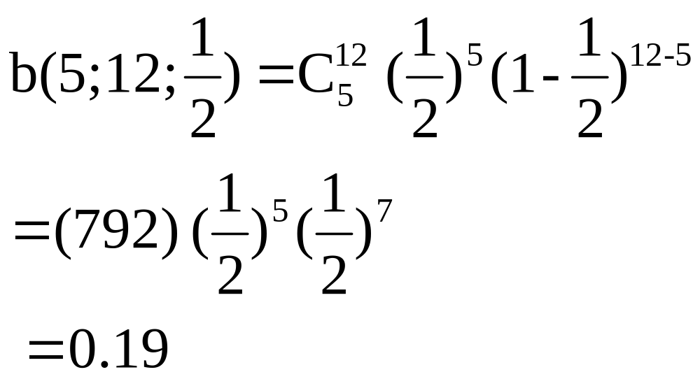
Example
Find the probability of getting 5 heads and seven tails in 12 flips of a balanced coin.

Slide 10
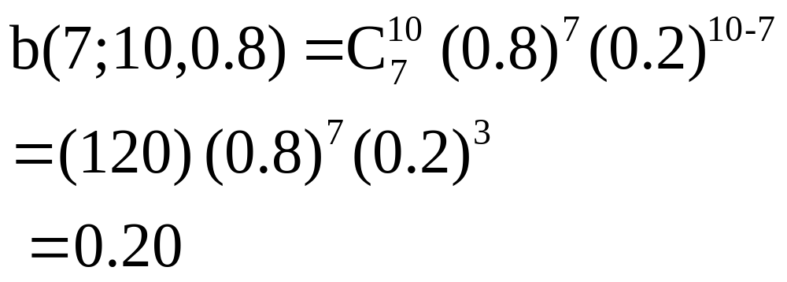
Example
Find the probability that seven of 10 persons will recover from a tropical disease, assuming independence. The probability that any one of them will recover from the disease is 0.80.

Slide 11
Mean and Variance
Mean: µ is called the mean of the distribution of X, or simply the mean of X
µ = nθ
Variance: σ² is called the variance of the distribution of X, and is given by
σ² = nθ(1- θ)

Slide 12
The Negative Binomial Distribution
Example:
If the probability is 0.40 that a child exposed to a certain contagious disease will catch it. What is the probability that the tenth child exposed to the disease will be the third to catch it?

Slide 13
The Negative Binomial Distribution
Θ = 0.40
Can we use binomial?
Note that the 3rd success is to occur on the 10th trial. Therefore in the 9 trials 2 successes has occurred and we can calculate the probability for this.

Slide 14
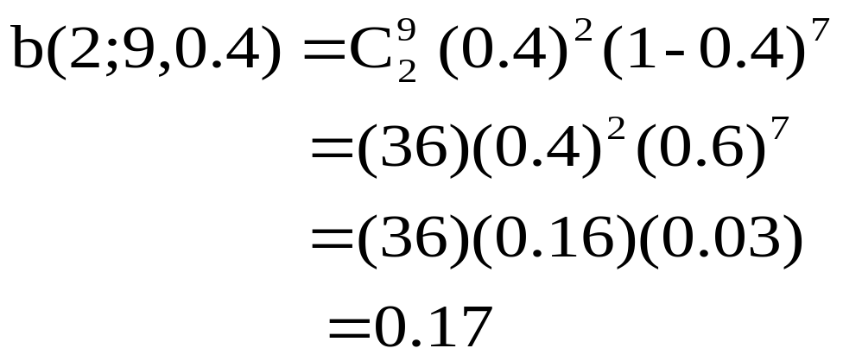
Example
0.17 is the probability that in 9 trials 2 children has caught the disease. Now on the 10th Bernoulli trial the third child is infected

Slide 15
Example
The probability of success on the 10th trial is 0.4
Therefore, the probability that the tenth child exposed to the disease will be the third to catch it is
0.4(0.17) = 0.07

Slide 16
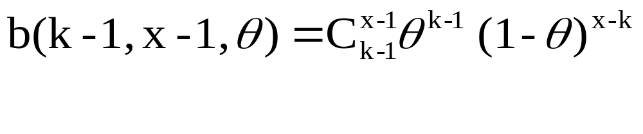
The Negative Binomial Distribution
Now, in general
If the k^{th} success is to occur on the x^{th} trial there must be k-1 successes in the first x-1 trials, and the probability for this is

Slide 17
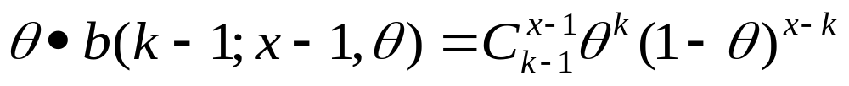
The Negative Binomial Distribution
The probability of success on the x^{th} trail is θ, and
The probability that the k^{th} success occurs on the x^{th} trial is therefore

Slide 18
The Negative Binomial Distribution
Definition
A random variable has a negative binomial distribution and it is referred to as a negative binomial random variable if and only if

Slide 19
The Negative Binomial Distribution
Mean: µ = k/θ
Variance: σ² = k/θ(1/θ - 1)

Slide 20

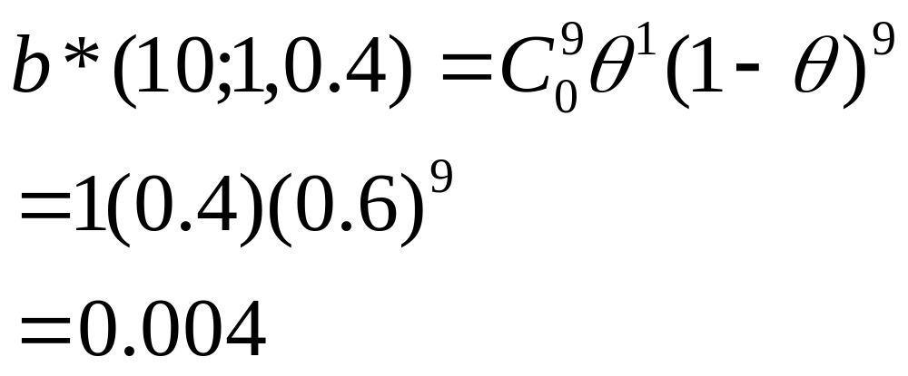
Example
If the probability is 0.4 that a child exposed to a contagious disease will catch it. What is the probability that the tenth child exposed to the disease will be the first to catch it

Slide 21
Geometric Distribution
Since the negative binomial distribution with k = 1 has so many important applications its given a special name, the Geometric Distribution
A random variable X has a geometric distribution and it is referred to as a geometric random variable if and only if its probability distribution is given by
g(x;θ) = θ(1- θ)^{x-1} for x = 1,2,3,…

Slide 22
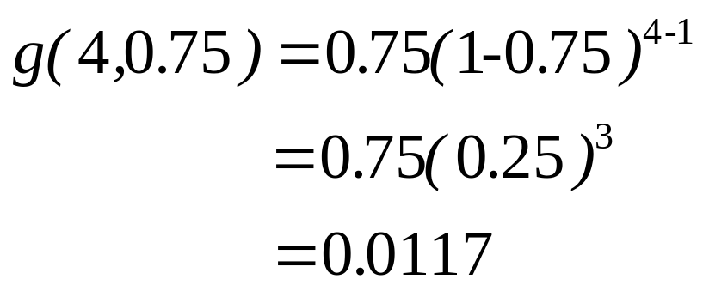
Example
If the probability is 0.75 that an applicant for a drivers license will pass the road test on any given try, what is the probability that an applicant will finally pass the test on the fourth try?

Slide 23

The Poisson Distribution
When n is large, the calculation of binomial probabilities using the binomial distribution will involve a prohibitive amount of work.
The Poisson Distribution can be used to approximate the Binomial probabilities when n is large (n -> ∞)and
θ is small (θ -> 0)

Slide 24
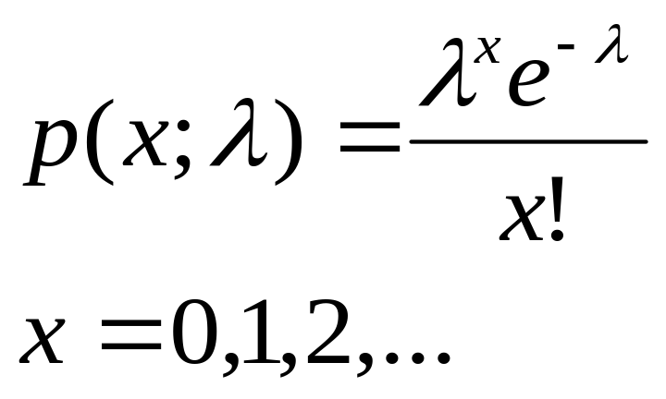
The Poisson Distribution
Definition
A random variable X has a Poisson Distribution and it is referred to as a Poisson random variable if and only if its probability distribution is given by. Where λ = nθ

Slide 25
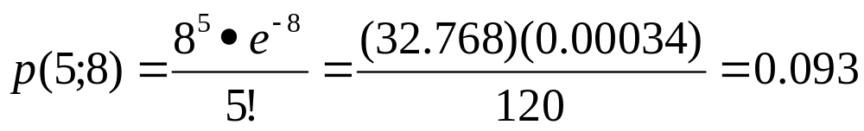
Example
If 2% of the books bound at a certain bindery have defective bindings, determine the probability that 5 of 400 books bound by this bindery will have defective bindings.

Slide 26
Topics Covered
Special Probability Distributions
  Bernoulli Distribution
  Binomial Distribution
  Negative Binomial Distribution
  Geometric Distribution
  Poisson Distribution

